Slide 1
Topic 4. Linear Regression

Slide 2

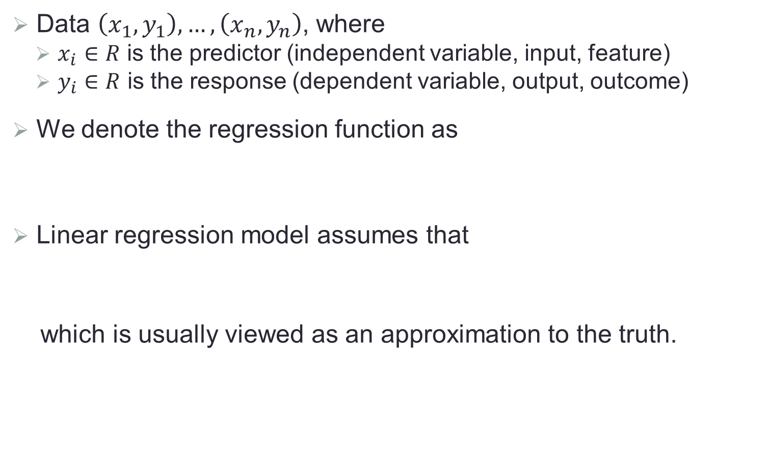

Simple Linear Regression
Data $\left(x_{1},y_{1}\right),…, \left(x_{n},y_{n}\right)$, where
$x_{i}∈R$ is the predictor (independent variable, input, feature)
$y_{i}∈R$ is the response (dependent variable, output, outcome)
We denote the regression function as
Linear regression model assumes that
which is usually viewed as an approximation to the truth.
$$f\left(x\right)=E\left(Y|X=x\right)$$
$$f\left(x\right)=β_{0}+β_{1}x$$

Slide 3
A Toy Example

Slide 4
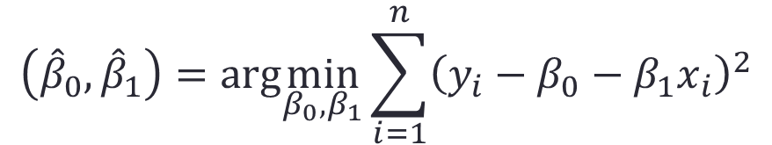
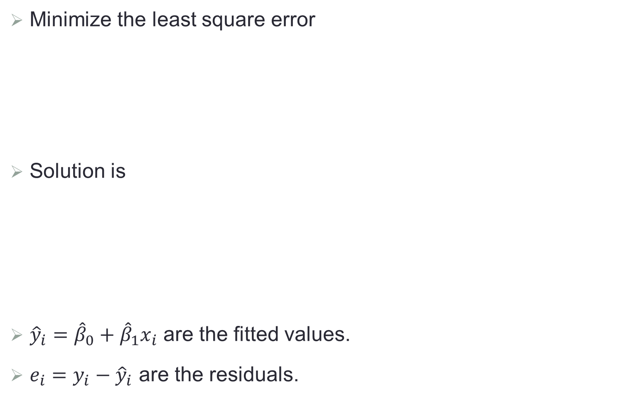

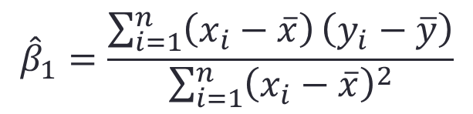
Least-squared Fitting
Minimize the least square error
Solution is
${\hat{y}}_{i}={\hat{β}}_{0}+{\hat{β}}_{1}x_{i}$ are the fitted values.
$e_{i}=y_{i}−{\hat{y}}_{i}$ are the residuals.
$$\left({\hat{β}}_{0},{\hat{β}}_{1}\right)=arg\min_{β_{0},β_{1}}{\sum_{i=1}^{n}{{\left(y_{i}−β_{0}−β_{1}x_{i}\right)}^{2}}}$$
$${\hat{β}}_{1}=\frac{\sum_{i=1}^{n}{\left(x_{i}−\overline{x}\right)}\left(y_{i}−\overline{y}\right)}{\sum_{i=1}^{n}{{\left(x_{i}−\overline{x}\right)}^{2}}}$$
$${\hat{β}}_{0}=\overline{y}−{\hat{β}}_{1}\overline{x}$$

Slide 5
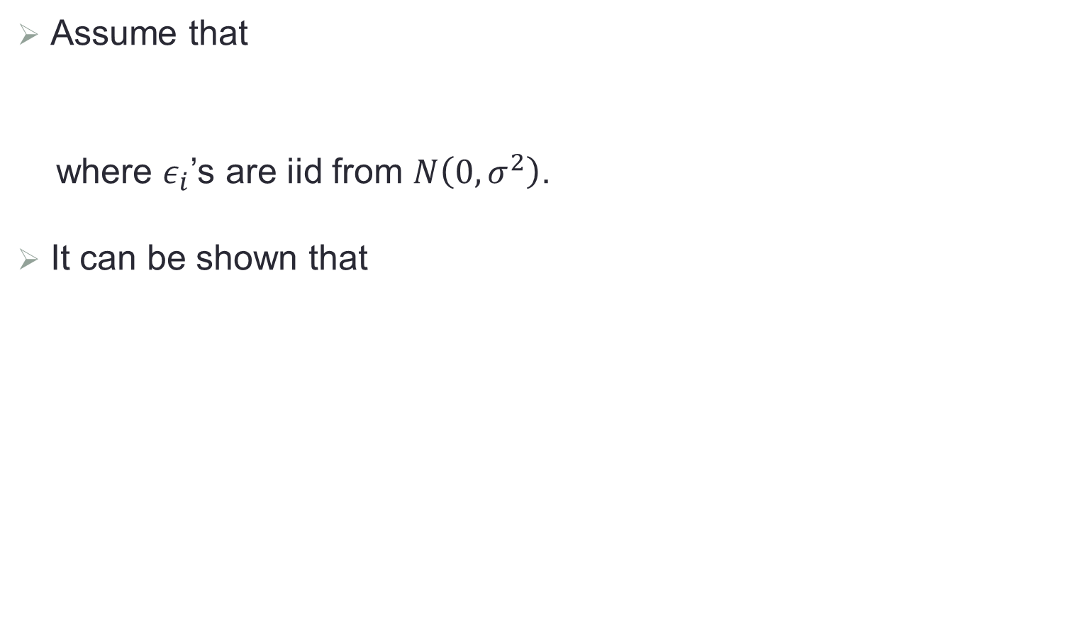

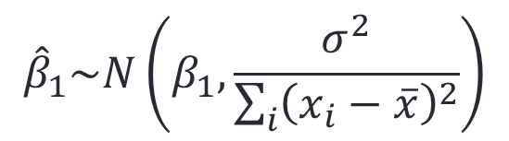
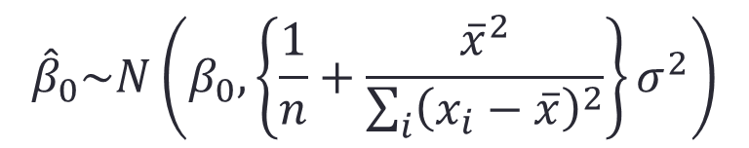

Point Estimation of $β_{0}$ and $β_{1}$
Assume that
where $ε_{i}$’s are iid from $N\left(0, σ^{2}\right)$.
It can be shown that
$$y_{i}=β_{0}+β_{1}x_{i}+ε_{i}$$
$${\hat{β}}_{1}\sim N\left(β_{1},\frac{σ^{2}}{\sum_{i}{{\left(x_{i}−\overline{x}\right)}^{2}}}\right)$$
$${\hat{β}}_{0}\sim N\left(β_{0}, \left\{\frac{1}{n}+\frac{{\overline{x}}^{2}}{\sum_{i}{{\left(x_{i}−\overline{x}\right)}^{2}}}\right\}σ^{2}\right)$$

Slide 6
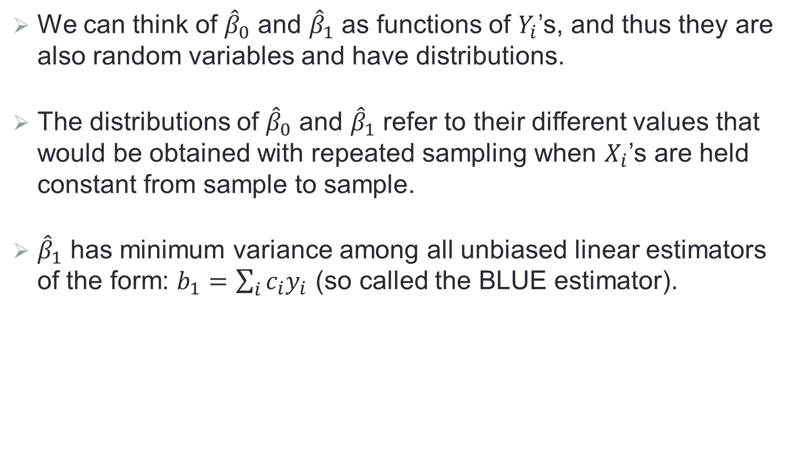
Some Remarks
We can think of ${\hat{β}}_{0}$ and ${\hat{β}}_{1}$ as functions of $Y_{i}$’s, and thus they are also random variables and have distributions.
The distributions of ${\hat{β}}_{0}$ and ${\hat{β}}_{1}$ refer to their different values that would be obtained with repeated sampling when $X_{i}$’s are held constant from sample to sample.
${\hat{β}}_{1}$ has minimum variance among all unbiased linear estimators of the form: $b_{1}=\sum_{i}{c_{i}y_{i}}$ (so called the BLUE estimator).

Slide 7
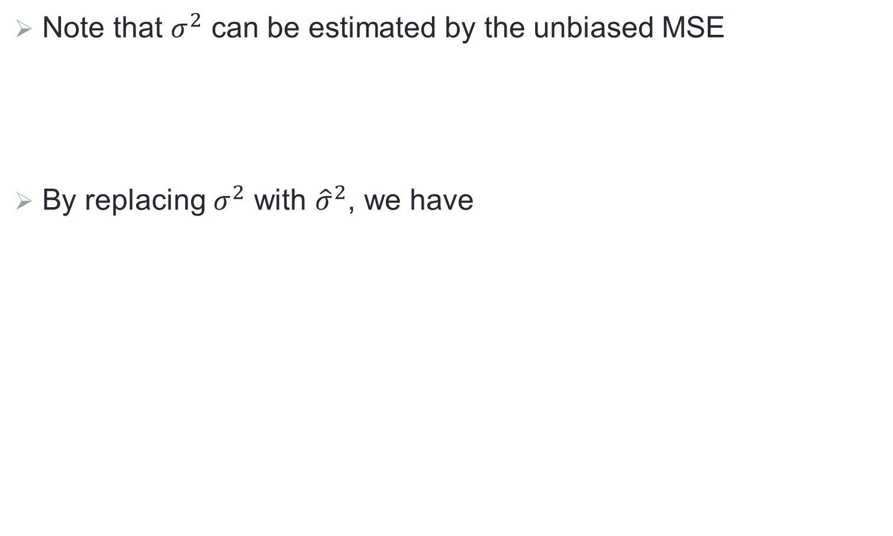

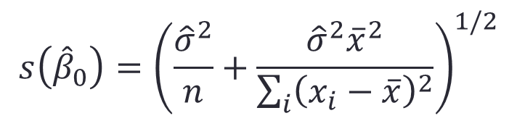
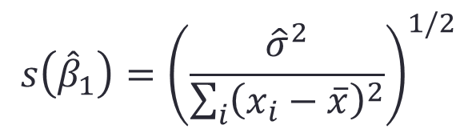
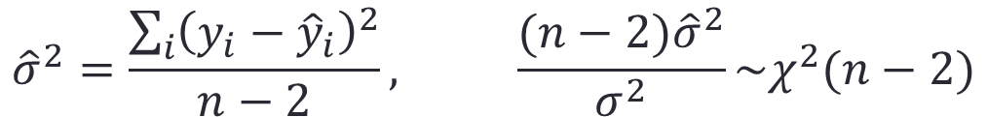
CI’s for $β_{0}$ and $β_{1}$
Note that $σ^{2}$ can be estimated by the unbiased MSE
By replacing $σ^{2}$ with ${\hat{σ}}^{2}$, we have
$${\hat{σ}}^{2}=\frac{\sum_{i}{{\left(y_{i}−{\hat{y}}_{i}\right)}^{2}}}{n−2}, \frac{(n−2){\hat{σ}}^{2}}{σ^{2}}\sim χ^{2}(n−2)$$
$$s\left({\hat{β}}_{1}\right)={\left(\frac{{\hat{σ}}^{2}}{\sum_{i}{{\left(x_{i}−\overline{x}\right)}^{2}}}\right)}^{1/2}$$
$$s\left({\hat{β}}_{0}\right)={\left(\frac{{\hat{σ}}^{2}}{n}+\frac{{\hat{σ}}^{2}{\overline{x}}^{2}}{\sum_{i}{{\left(x_{i}−\overline{x}\right)}^{2}}}\right)}^{1/2}$$

Slide 8
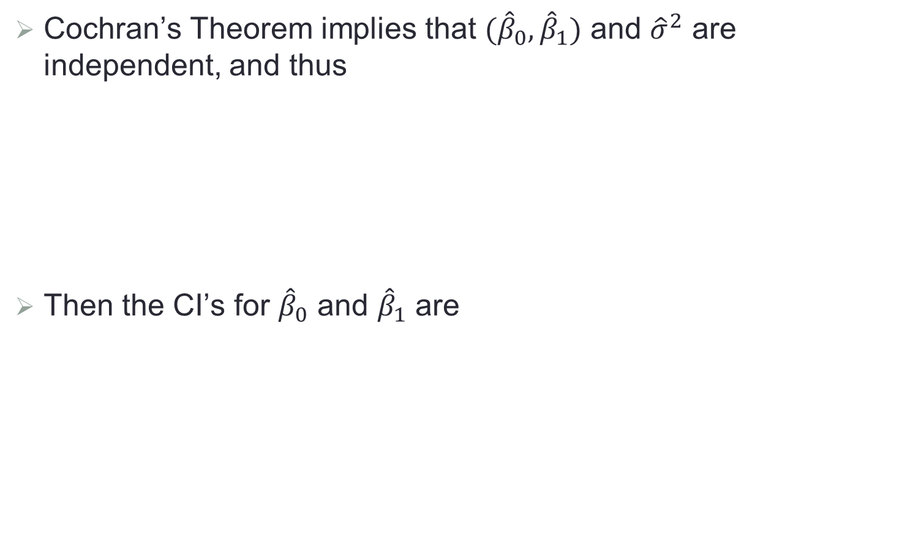

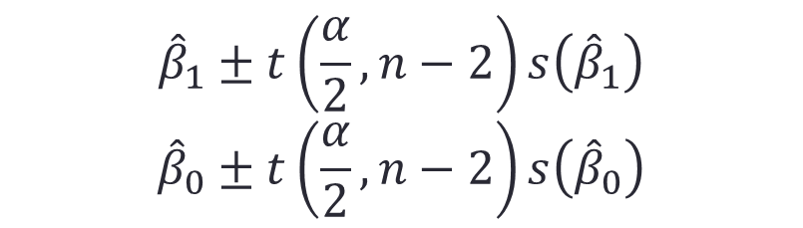
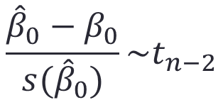
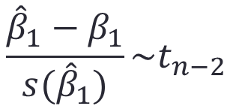
CI’s for $β_{0}$ and $β_{1}$ (Cont.)
Cochran’s Theorem implies that ${(\hat{β}}_{0}, {\hat{β}}_{1})$ and ${\hat{σ}}^{2}$ are independent, and thus
Then the CI’s for ${\hat{β}}_{0}$ and ${\hat{β}}_{1}$ are
$$\frac{{\hat{β}}_{1}−β_{1}}{s({\hat{β}}_{1})}\sim t_{n−2}$$
$$\frac{{\hat{β}}_{0}−β_{0}}{s({\hat{β}}_{0})}\sim t_{n−2}$$
$${\hat{β}}_{1}±t\left(\frac{α}{2},n−2\right)s\left({\hat{β}}_{1}\right)$$
$${\hat{β}}_{0}±t\left(\frac{α}{2},n−2\right)s\left({\hat{β}}_{0}\right)$$

Slide 9
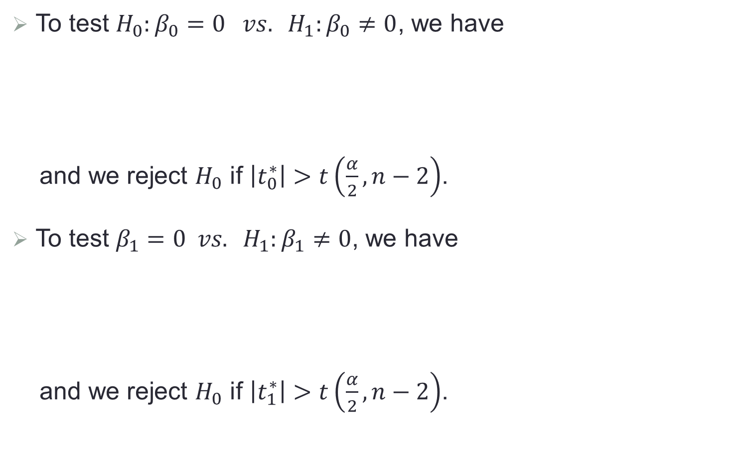
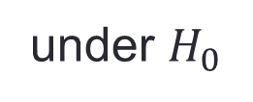

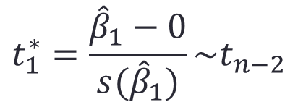
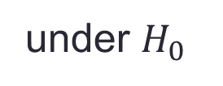
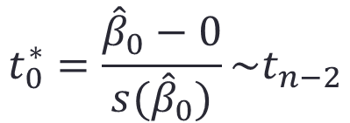
Hypothesis Test for $β_{0}$ and $β_{1}$
To test $H_{0}:β_{0}=0 vs. H_{1}:β_{0}≠0$, we have
and we reject $H_{0}$ if $\left|t_{0}^{∗}\right|>t\left(\frac{α}{2},n−2\right)$.
To test $β_{1}=0 vs. H_{1}:β_{1}≠0$, we have
and we reject $H_{0}$ if $\left|t_{1}^{∗}\right|>t\left(\frac{α}{2},n−2\right)$.
$$t_{0}^{∗}=\frac{{\hat{β}}_{0}−0}{s({\hat{β}}_{0})}\sim t_{n−2}$$
under $H_{0}$
$$t_{1}^{∗}=\frac{{\hat{β}}_{1}−0}{s({\hat{β}}_{1})}\sim t_{n−2}$$
under $H_{0}$

Slide 10
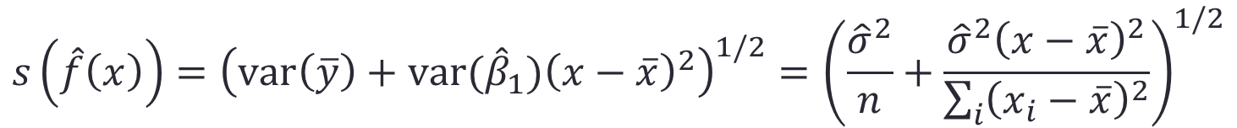
Fitted Line
$$\hat{f}\left(x\right)={\hat{β}}_{0}+{\hat{β}}_{1}x=\overline{y}+{\hat{β}}_{1}(x−\overline{x})$$
$$s\left(\hat{f}\left(x\right)\right)={\left(var\left(\overline{y}\right)+var({\hat{β}}_{1}){\left(x−\overline{x}\right)}^{2}\right)}^{1/2}={\left(\frac{{\hat{σ}}^{2}}{n}+\frac{{\hat{σ}}^{2}{\left(x−\overline{x}\right)}^{2}}{\sum_{i}{{\left(x_{i}−\overline{x}\right)}^{2}}}\right)}^{1/2}$$

Slide 11
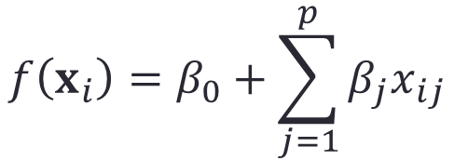
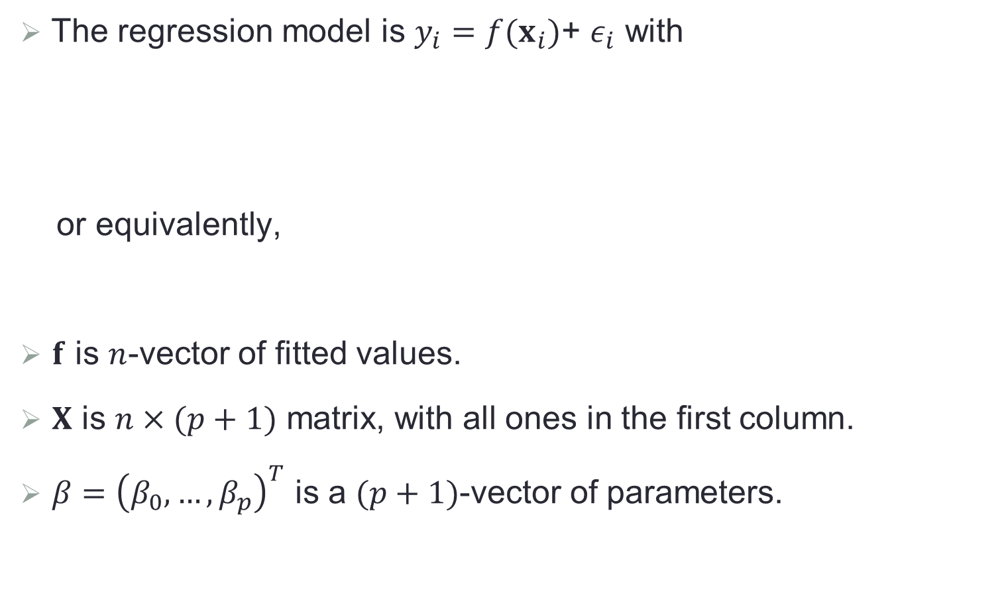

Multiple Linear Regression
The regression model is $y_{i}=f(x_{i})$+ $ε_{i}$ with
or equivalently,
$f$ is $n$-vector of fitted values.
$X$ is $n×(p+1)$ matrix, with all ones in the first column.
$β={\left(β_{0},…,β_{p}\right)}^{T}$ is a $(p+1)$-vector of parameters.
$$f\left(x_{i}\right)=β_{0}+\sum_{j=1}^{p}{β_{j}x_{ij}}$$
$f=Xβ$

Slide 12
An Illustrative Plot

Slide 13

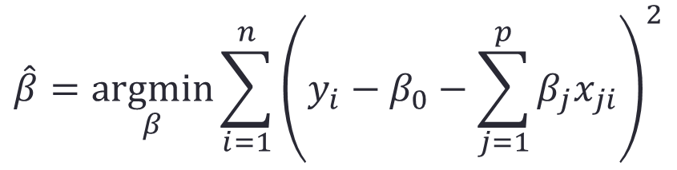

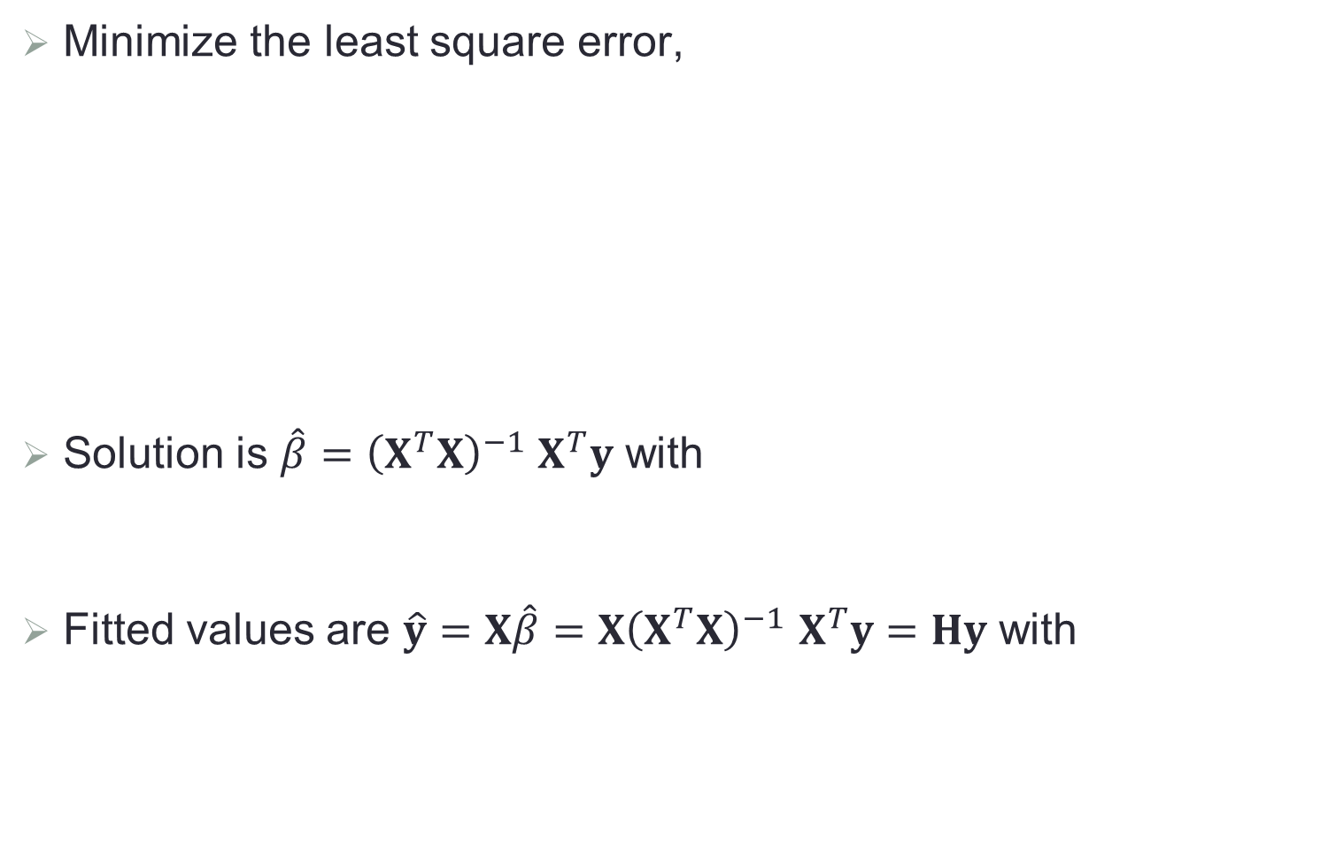


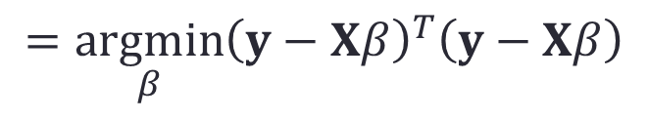
Least Squares Fitting
Minimize the least square error,
Solution is $\hat{β}={\left(X^{T}X\right)}^{−1}$ $X^{T}y$ with
Fitted values are $\hat{y}=X\hat{β}={X\left(X^{T}X\right)}^{−1} X^{T}y=Hy$ with
$$\hat{β}=\underset{β}{argmin}{\sum_{i=1}^{n}{{\left(y_{i}−β_{0}−\sum_{j=1}^{p}{β_{j}x_{ji}}\right)}^{2}}}$$
$$=\underset{β}{argmin}{{\left(y−Xβ\right)}^{T}\left(y−Xβ\right)}$$
$$E\left(\hat{β}\right)=β$$
$$cov\left(\hat{β}\right)=σ^{2}{\left(X^{T}X\right)}^{−1}$$
$$E\left(\hat{y}\right)=xβ$$
$$cov\left(\hat{y}\right)=σ^{2}H$$

Slide 14

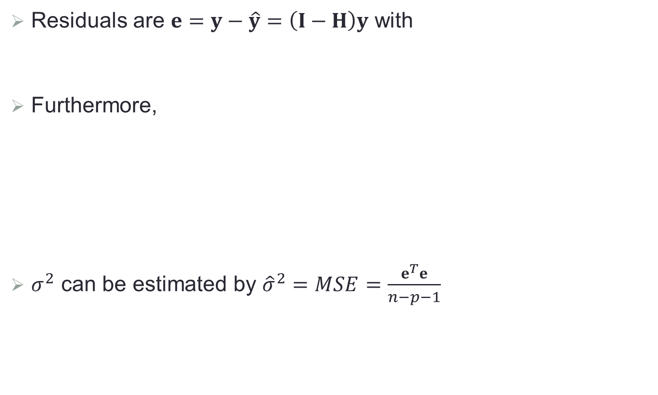


Residual Properties
Residuals are $e=y−\hat{y}=\left(I−H\right)y$ with
Furthermore,
$σ^{2}$ can be estimated by ${\hat{σ}}^{2}=MSE=\frac{e^{T}e}{n−p−1}$
$$E\left(e\right)=0$$
$$cov\left(e\right)=σ^{2}\left(I−H\right)$$
$$E\left(e^{T}e\right)=E\left(tr\left(e^{T}e\right)\right)=E\left(tr\left(ee^{T}\right)\right)=tr\left(E\left(ee^{T}\right)\right)$$
$$=tr\left(σ^{2}\left(I−H\right)\right)=σ^{2}(n−p−1)$$
with
$$tr\left(H\right)=tr\left({X\left(X^{T}X\right)}^{−1} X^{T}\right)=tr\left(I_{p+1}\right)=p+1$$

Slide 15


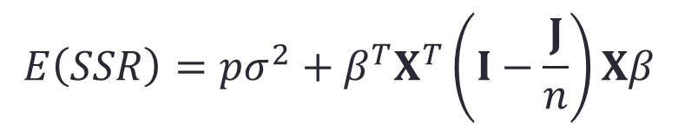
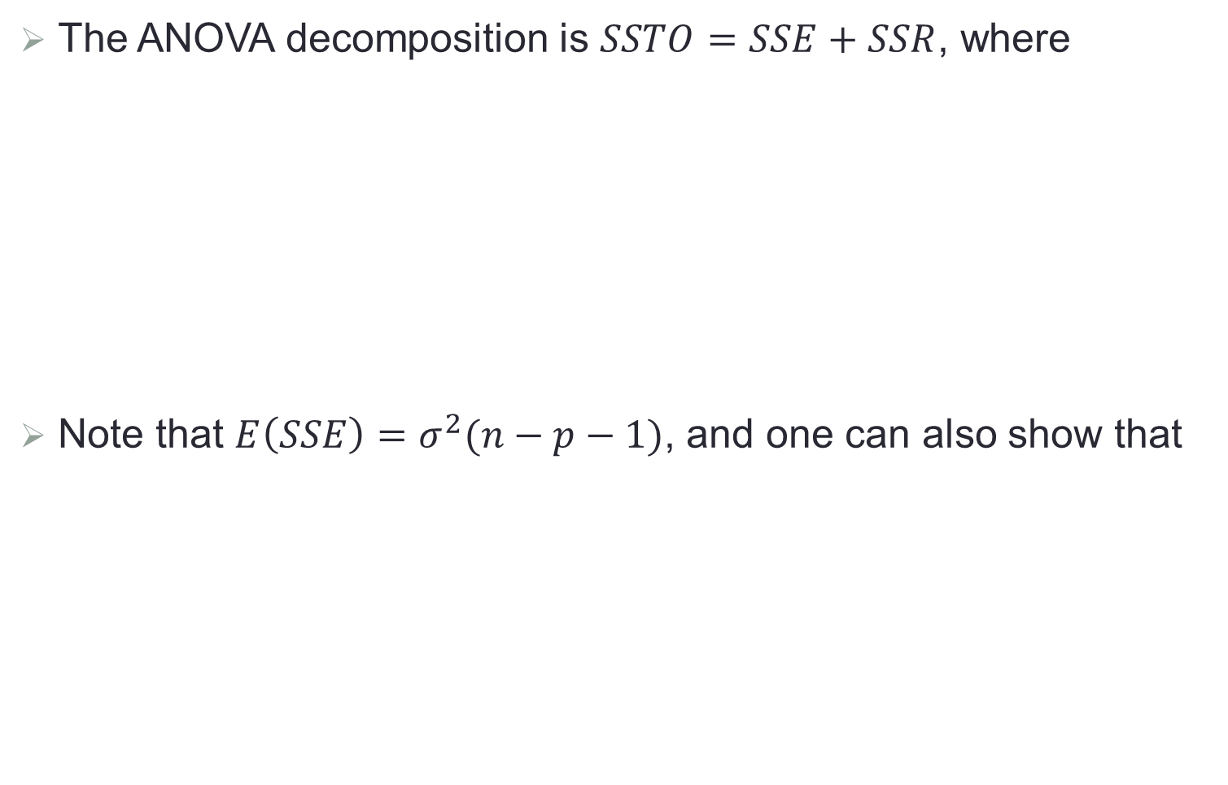
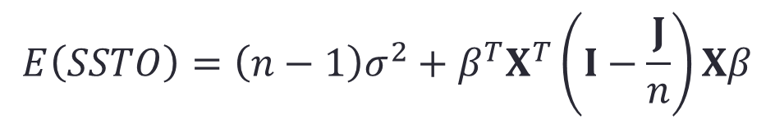
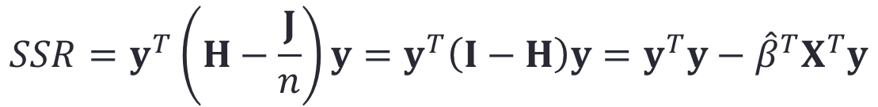
Analysis of Variance (ANOVA)
The ANOVA decomposition is $SSTO=SSE+SSR$, where
Note that $E\left(SSE\right)=σ^{2}(n−p−1)$, and one can also show that
$$SSTO=y^{T}\left(I−\frac{J}{n}\right)y$$
$J$ is the matrix with all ones.
$$SSE=e^{T}e=y^{T}\left(I−H\right)y=y^{T}y−{\hat{β}}^{T}X^{T}y$$
$$SSR=y^{T}\left(H−\frac{J}{n}\right)y=y^{T}\left(I−H\right)y=y^{T}y−{\hat{β}}^{T}X^{T}y$$
$$E\left(SSTO\right)=\left(n−1\right)σ^{2}+β^{T}X^{T}\left(I−\frac{J}{n}\right)Xβ$$
$$E\left(SSR\right)=pσ^{2}+β^{T}X^{T}\left(I−\frac{J}{n}\right)Xβ$$

Slide 16
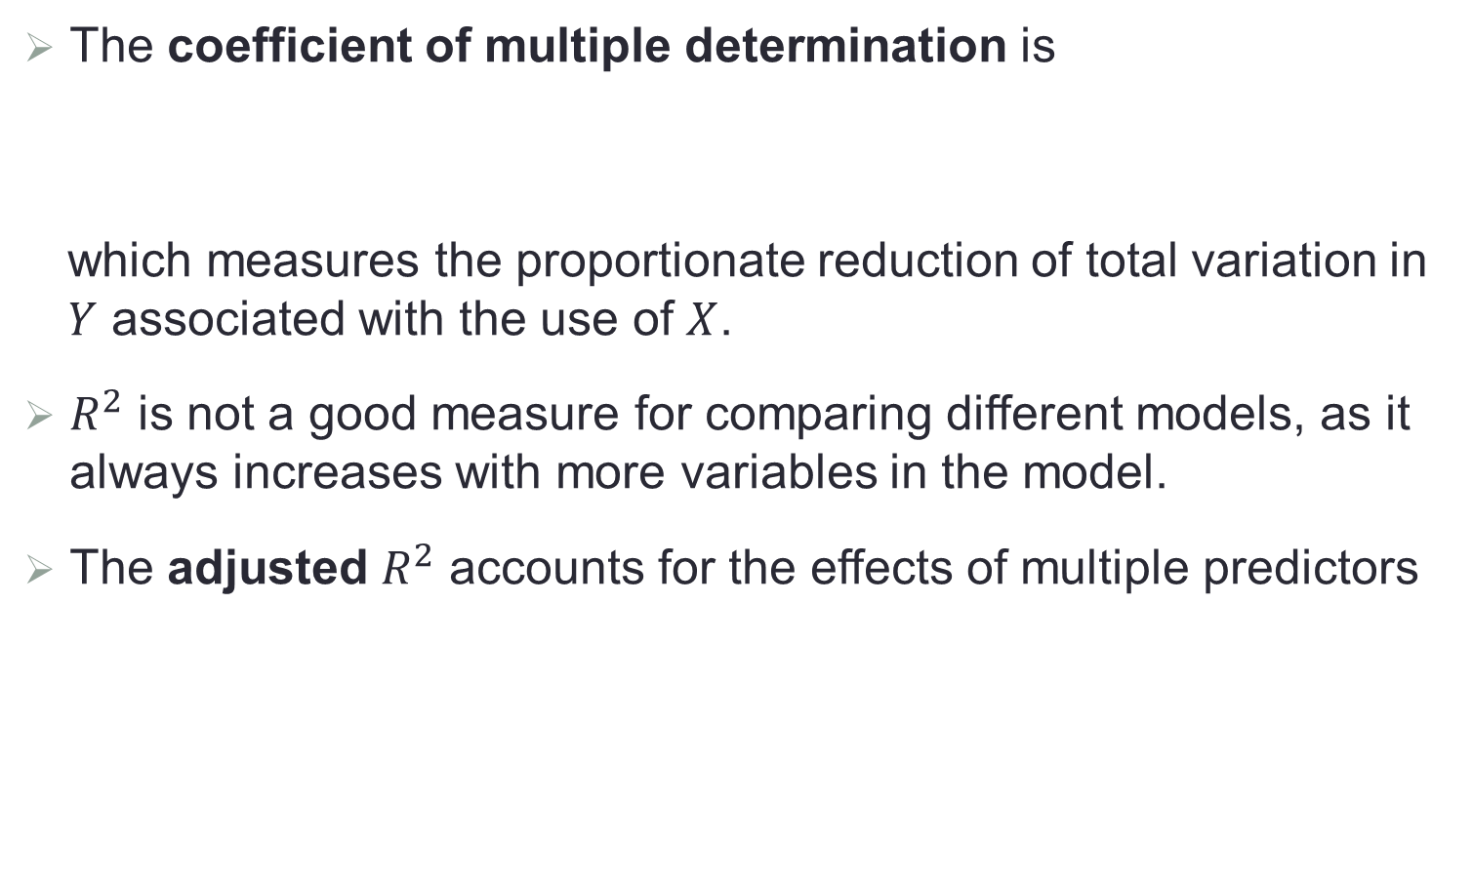

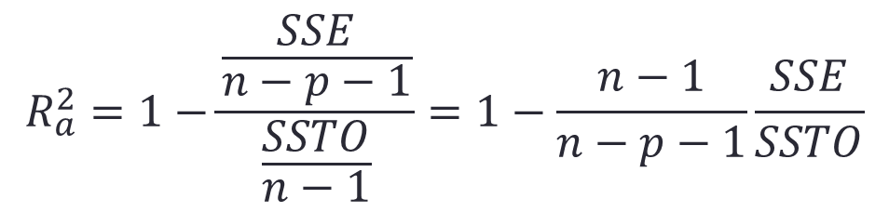
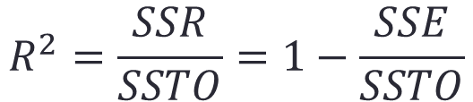
$R^{2}$ for Regression
The coefficient of multiple determination is
which measures the proportionate reduction of total variation in $Y$ associated with the use of $X$.
$R^{2}$ is not a good measure for comparing different models, as it always increases with more variables in the model.
The adjusted $R^{2}$ accounts for the effects of multiple predictors
$$R^{2}=\frac{SSR}{SSTO}=1−\frac{SSE}{SSTO}$$
$$R_{a}^{2}=1−\frac{\frac{SSE}{n−p−1}}{\frac{SSTO}{n−1}}=1−\frac{n−1}{n−p−1}\frac{SSE}{SSTO}$$

Slide 17

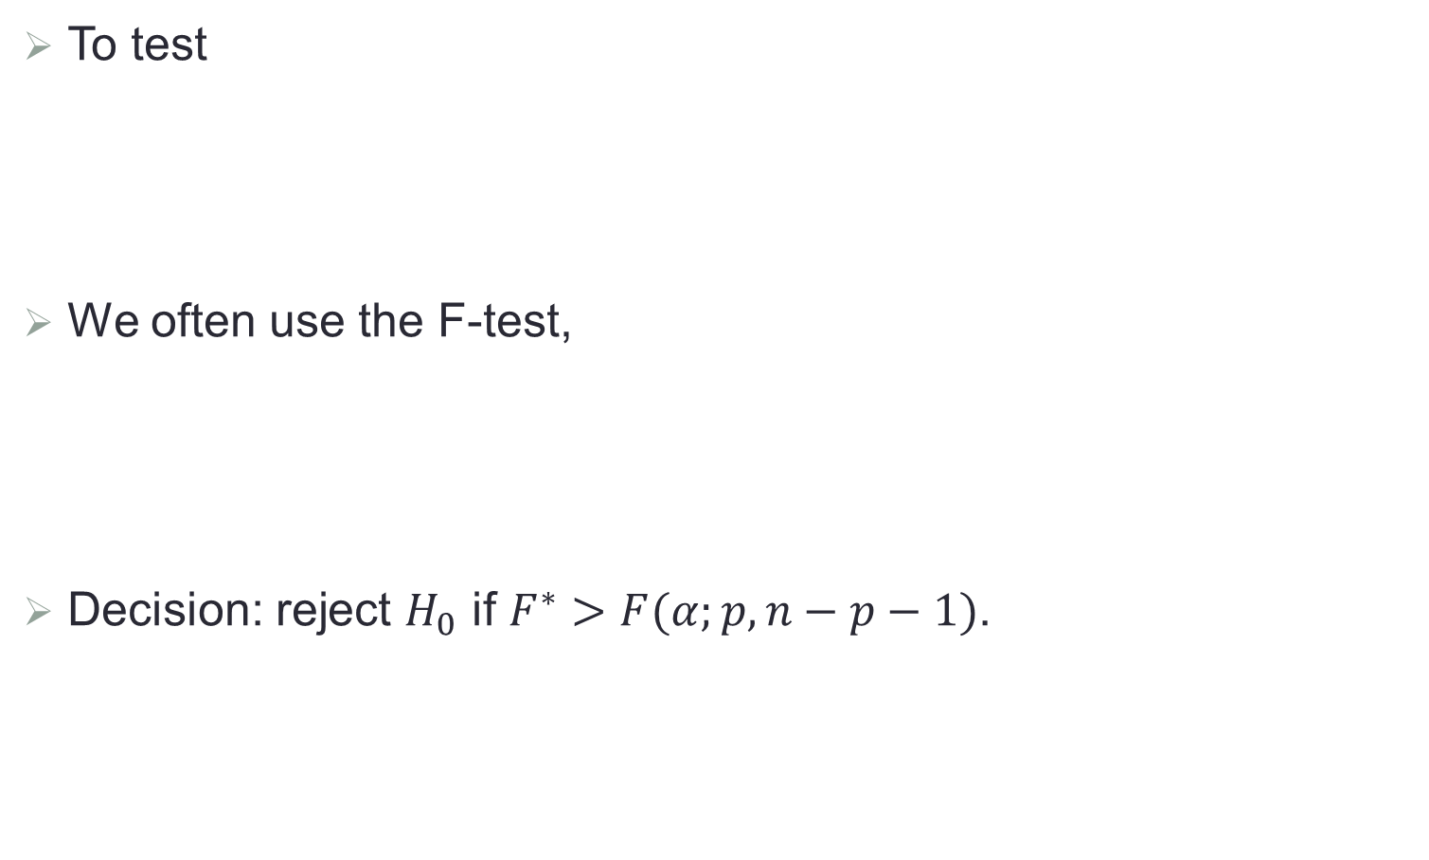
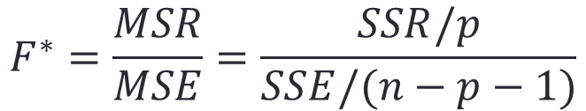

Test for Linear Model
To test
We often use the F-test,
Decision: reject $H_{0}$ if $F^{∗}>F(α;p,n−p−1)$.
$$H_{0}: β_{1}=β_{2}=…=β_{p}=0$$
$$H_{a}:not all β_{k}=0 (k≥1)$$
$$F^{∗}=\frac{MSR}{MSE}=\frac{SSR/p}{SSE/(n−p−1)}$$

Slide 18

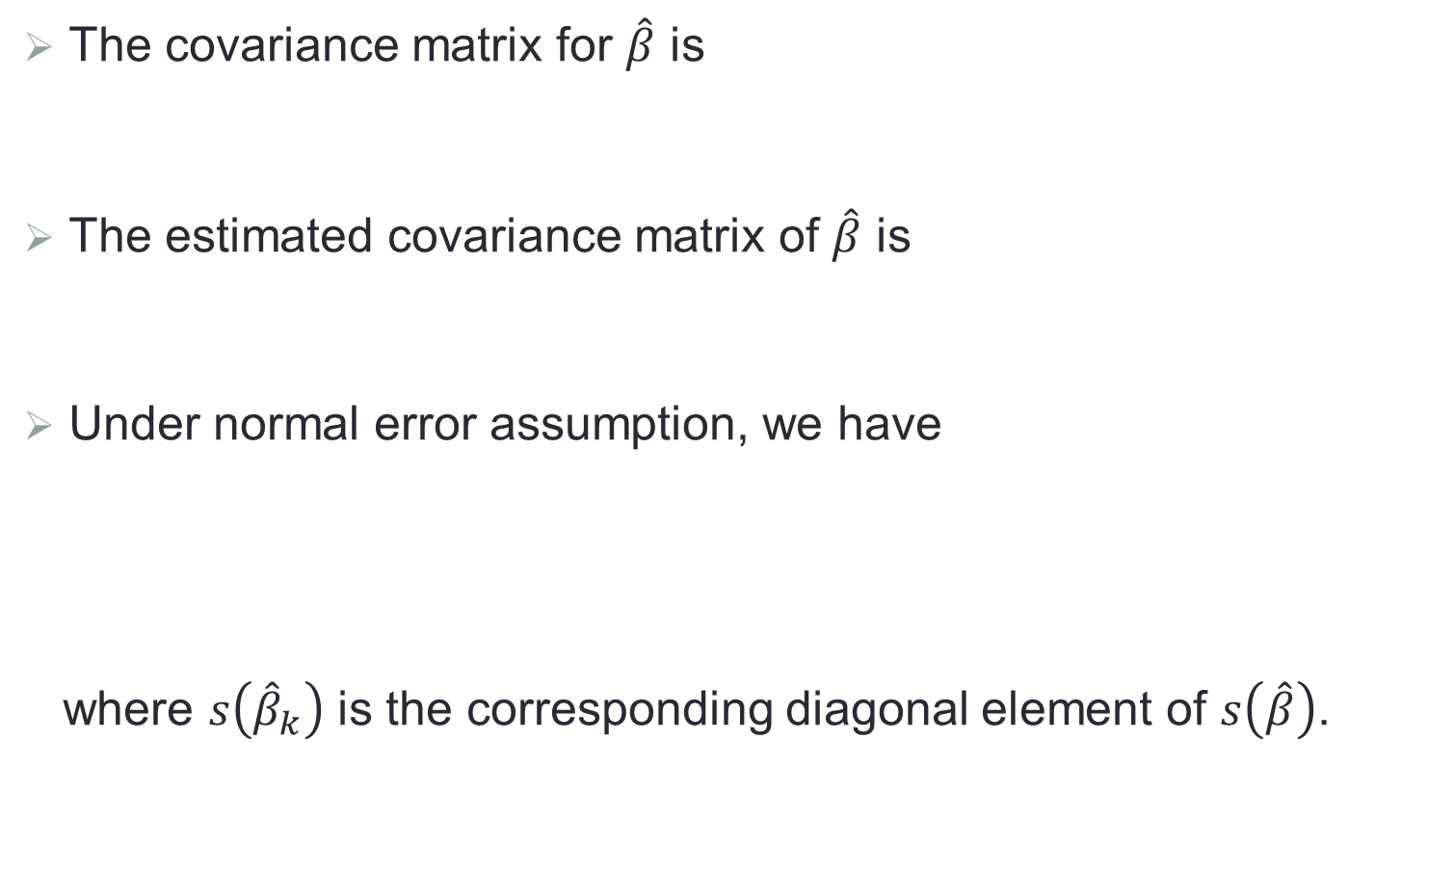
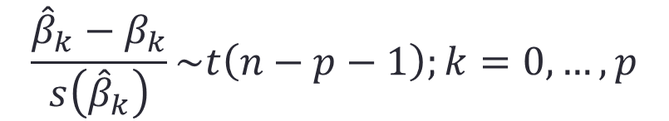

Test for Coefficients
The covariance matrix for $\hat{β}$ is
The estimated covariance matrix of $\hat{β}$ is
Under normal error assumption, we have
where $s\left({\hat{β}}_{k}\right)$ is the corresponding diagonal element of $s\left(\hat{β}\right)$.
$$cov\left(\hat{β}\right)=σ^{2}{\left(X^{T}X\right)}^{−1}$$
$$s^{2}\left(\hat{β}\right)=MSE{\left(X^{T}X\right)}^{−1}$$
$$\frac{{\hat{β}}_{k}−β_{k}}{s\left({\hat{β}}_{k}\right)}\sim t\left(n−p−1\right);k=0,…,p$$

Slide 19
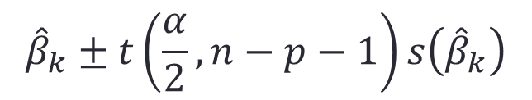
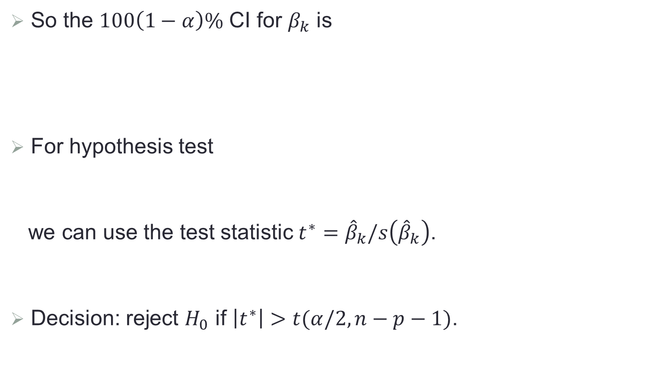

Test for Coefficients (Cont.)
So the $100\left(1−α\right)\%$ CI for $β_{k}$ is
For hypothesis test
we can use the test statistic $t^{∗}={\hat{β}}_{k}/s\left({\hat{β}}_{k}\right)$.
Decision: reject $H_{0}$ if $\left|t^{∗}\right|>t(α/2,n−p−1)$.
$${\hat{β}}_{k}±t\left(\frac{α}{2},n−p−1\right)s\left({\hat{β}}_{k}\right)$$
$$H_{0}: β_{k}=0, H_{a}: β_{k}≠0$$

Slide 20

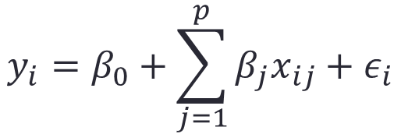
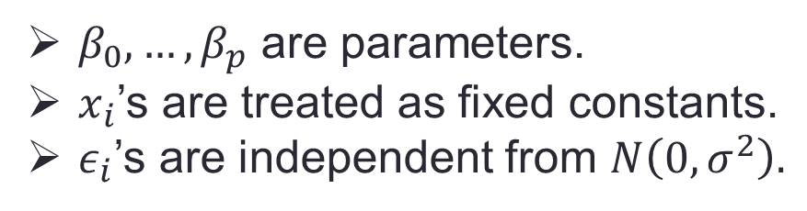
Model Diagnostics
Recall the normal error assumption model,
Can the model be inadequate? If yes, in what aspect? And how to remedy the model?
$$y_{i}=β_{0}+\sum_{j=1}^{p}{β_{j}x_{ij}}+ε_{i}$$
$$i=1,…,n$$
where
$β_{0},…,β_{p}$ are parameters.
$x_{i}$’s are treated as fixed constants.
$ε_{i}$’s are independent from $N\left(0, σ^{2}\right).$

Slide 21
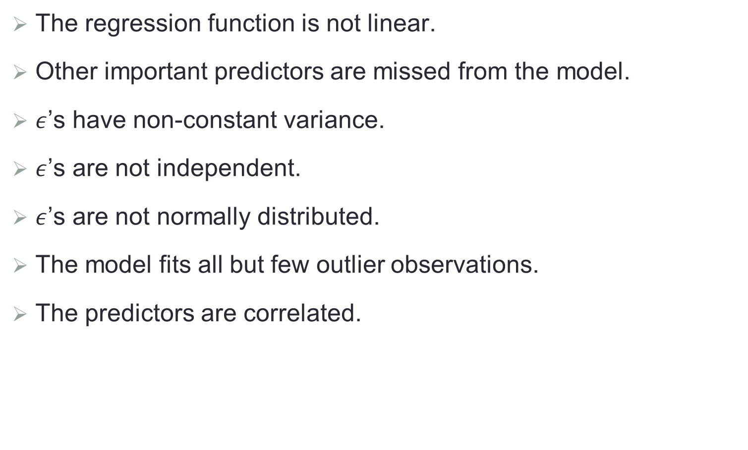
Potential Issues
The regression function is not linear.
Other important predictors are missed from the model.
$ε$’s have non-constant variance.
$ε$’s are not independent.
$ε$’s are not normally distributed.
The model fits all but few outlier observations.
The predictors are correlated.

Slide 22
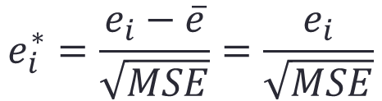
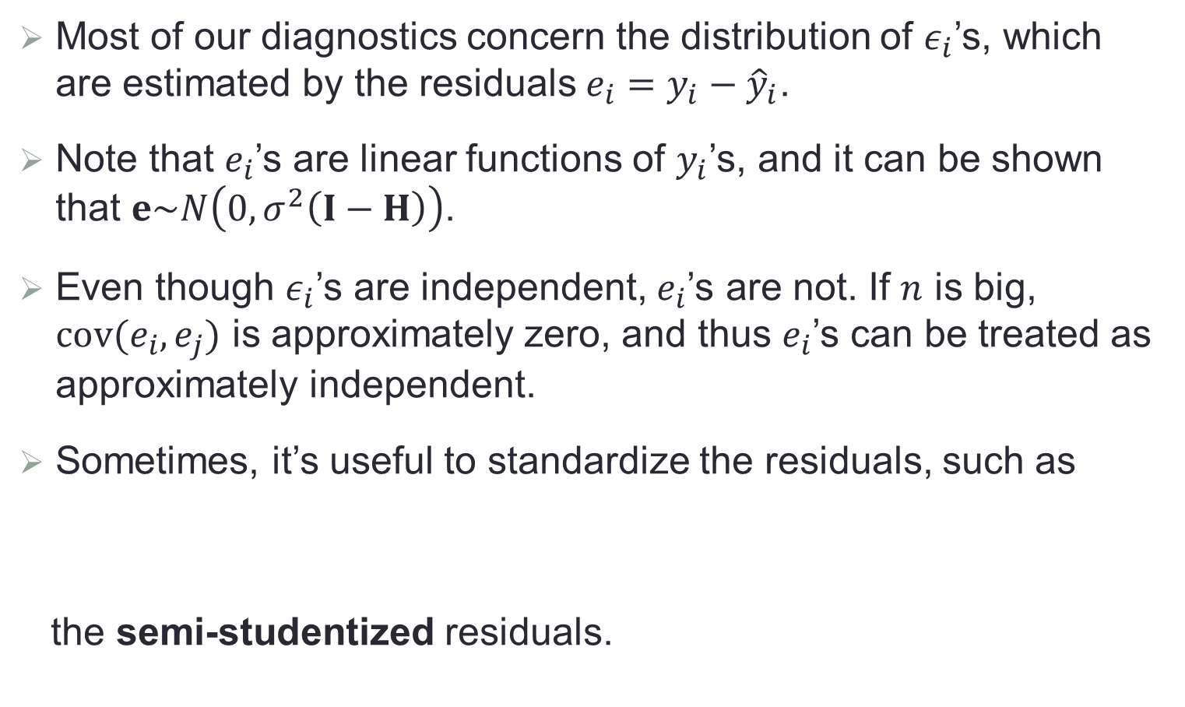
Residual Properties
Most of our diagnostics concern the distribution of $ε_{i}$’s, which are estimated by the residuals $e_{i}=y_{i}−{\hat{y}}_{i}$.
Note that $e_{i}$’s are linear functions of $y_{i}$’s, and it can be shown that $e\sim N\left(0, σ^{2}\left(I−H\right)\right)$.
Even though $ε_{i}$’s are independent, $e_{i}$’s are not. If $n$ is big, $cov(e_{i},e_{j})$ is approximately zero, and thus $e_{i}$’s can be treated as approximately independent.
Sometimes, it’s useful to standardize the residuals, such as
the semi-studentized residuals.
$$e_{i}^{∗}=\frac{e_{i}−\overline{e}}{\sqrt{MSE}}=\frac{e_{i}}{\sqrt{MSE}}$$

Slide 23
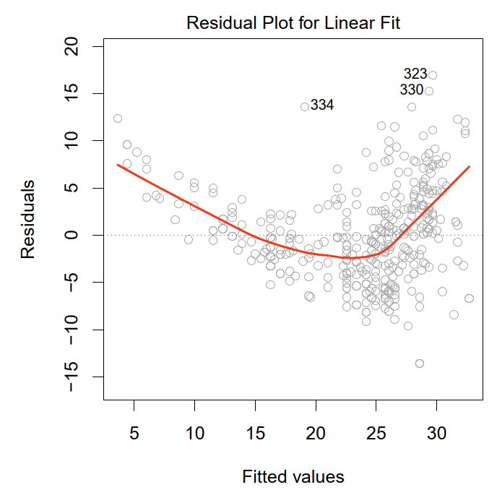
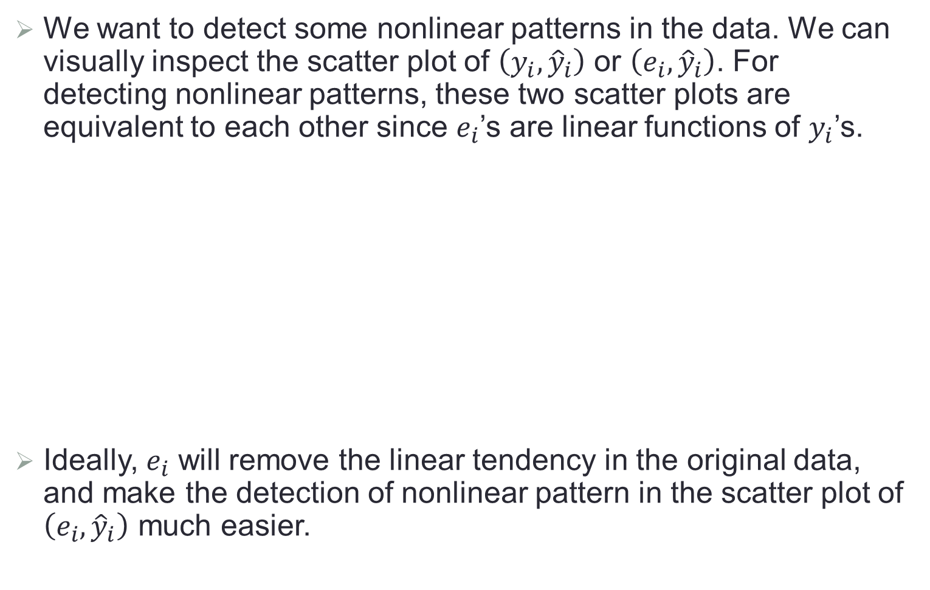
Nonlinearity of Regression Function
We want to detect some nonlinear patterns in the data. We can visually inspect the scatter plot of $\left(y_{i},{\hat{y}}_{i}\right)$ or $\left(e_{i},{\hat{y}}_{i}\right)$. For detecting nonlinear patterns, these two scatter plots are equivalent to each other since $e_{i}$’s are linear functions of $y_{i}$’s.
Ideally, $e_{i}$ will remove the linear tendency in the original data, and make the detection of nonlinear pattern in the scatter plot of $\left(e_{i},{\hat{y}}_{i}\right)$ much easier.

Slide 24
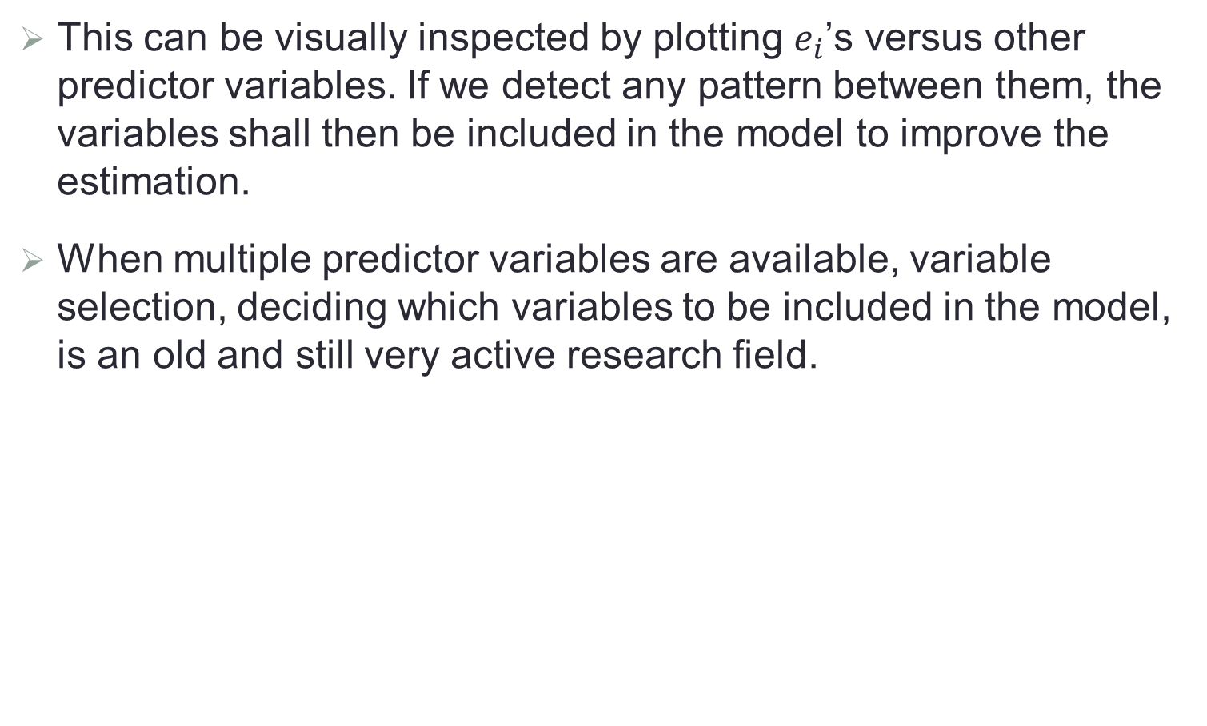
Omission of Important Predictor Variables
This can be visually inspected by plotting $e_{i}$’s versus other predictor variables. If we detect any pattern between them, the variables shall then be included in the model to improve the estimation.
When multiple predictor variables are available, variable selection, deciding which variables to be included in the model, is an old and still very active research field.

Slide 25
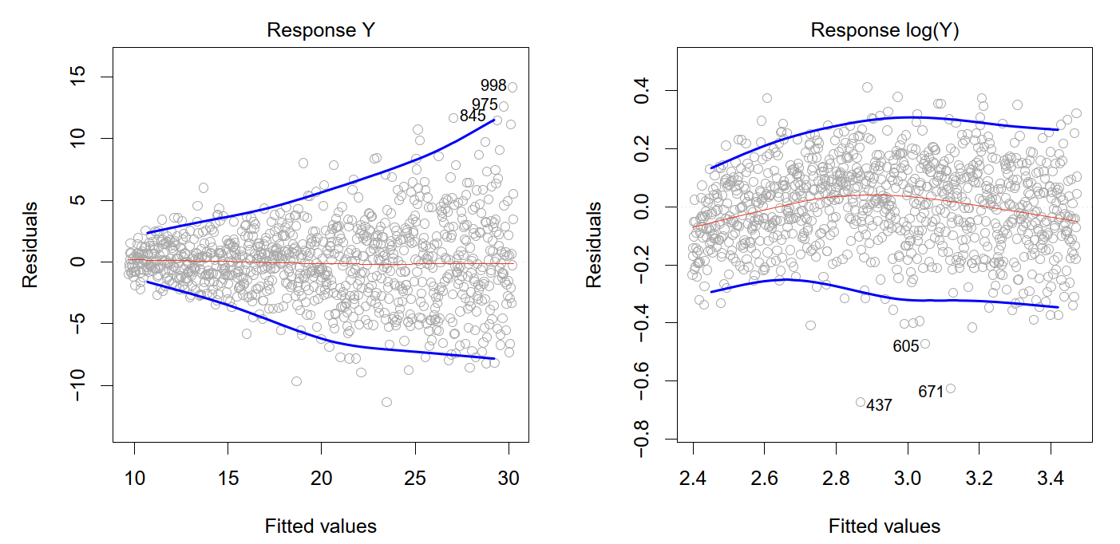

Non-constancy of Error Variance (Heteroscedasticity)
We can inspect the scatter plot of $\left(e_{i}, {\hat{y}}_{i}\right)$. If the error variance is indeed constant, all residuals $e_{i}$’s should have roughly the same magnitude.
Since the signs of $e_{i}$’s are not much meaningful for examining the constant error variance, it is often useful to plot $\left|e_{i}\right|$ against ${\hat{y}}_{i}$.

Slide 26



Dependence of Error Terms
In time series or spatial data, it is always useful to inspect the scatter plot of $e_{i}$’s versus time or geographical locations.
The goal is to see if there is any correlation between $e_{i}$’s that are near each other in the sequence.

Slide 27

Non-normality of Error Term
Several ways to inspect the normality of $e_{i}$’s:
Distribution plot: histogram, boxplot, stem-and-leaf for inspecting distribution
Cumulative distribution function estimation comparison: sample frequency estimates the cumulative distribution function, which can be compared to the theoretical values.
QQ plot: a plot that is nearly linear suggests agreement with normality, whereas a plot that departs substantially from linearity suggests that the errors are not normally distributed.

Slide 28



Outlying Observations
When some observations are well separated from the majority of the data, these cases are called outlying. A case may be outlying with respect to its Y value, its X value(s), or both.
Outlying Y observations (outliers): data point for which $y_{i}$ is far from the value predicted by the model
Outlying X observations (high leverage points): data points that have an unusual X value

Slide 29



Outlying Y Observations
Outliers can arise for a variety of reasons such as measurement error and recording error.
Residual plots can be used to identify outliers. There are different definitions of residuals used to detect outliers.
Residuals and semi-studentized residuals
Studentized residuals
$$e_{i}=y_{i}−{\hat{y}}_{i}$$
$$e_{i}^{∗}=\frac{e_{i}}{\sqrt{MSE}}$$
$$r_{i}=\frac{e_{i}}{s(e_{i})}=\frac{e_{i}}{\sqrt{MSE(1−h_{ii})}}$$

Slide 30



Outlying Y Observations (Cont.)
Deleted residual is the difference between observations and its fitted value from a regression model without using the observation
where ${\hat{y}}_{i(−i)}$ is the estimate of $E(Y|X=x_{i})$ from a model fitting without using $\left(x_{i},y_{i}\right).$
We can show that
$$d_{i}=y_{i}−{\hat{y}}_{i(−i)}$$
$$d_{i}=\frac{e_{i}}{1−h_{ii}}$$

Slide 31


Outlying Y Observations (Cont.)
The deleted residual mimics the prediction error for a new observation.
Its estimated variance can be obtained as
where ${MSE}_{(−i)}$ is computed when the $\left(x_{i},y_{i}\right)$ is omitted in the fitting, and $X_{(−i)}$ is the $X$ matrix without the $x_{i}$ row.
It can be shown that
$$s^{2}\left(d_{i}\right)={MSE}_{(−i)}\left(1+x_{i}^{′}{\left(X_{(−i)}^{′}X_{(−i)}\right)}^{−1}x_{i}\right)$$
$$s^{2}\left(d_{i}\right)=\frac{{MSE}_{(−i)}}{1−h_{ii}}$$

Slide 32




Outlying Y Observations (Cont.)
The studentized deleted residual is defined as
We can show that
So
We can formally test for outlying Y observations by comparing $\left|t_{i}\right|$ with $t(1−\frac{α}{2n},n−p−2)$, which adjusts for the $n$ observations following Bonferroni procedure.
$$t_{i}=\frac{d_{i}}{s(d_{i})}=\frac{e_{i}}{\sqrt{{MSE}_{\left(−i\right)}(1−h_{ii})}}\sim t_{n−p−2}$$
$$\left(n−p−1\right)MSE=\left(n−p−2\right){MSE}_{\left(−i\right)}+\frac{e_{i}^{2}}{1−h_{ii}}$$
$$t_{i}=e_{i}{\left\{\frac{n−p−2}{SSE\left(1−h_{ii}\right)−e_{i}^{2}}\right\}}^{1/2}$$

Slide 33

Outlying X Observations
The diagonal elements of H are useful indicators of whether an observation is outlying with respect to its X values.
We have $0≤h_{ii}≤1$ and $\sum_{i=1}^{n}{h_{ii}=tr(H)}=p+1$.
$h_{ii}$ is called the leverage of the $i$th case, and measures the distance between $x_{i}$ and the center of all the X values.
Thus a large $h_{ii}$ indicates that $x_{i}$ is distant from the center of all the X values.
In general, a leverage value greater than $2(p+1)/n$ is considered to indicating outlying observation with regard to its X values.

Slide 34

Multicollinearity (Collinearity)
Ideally, predictor variables in multiple regression are independent of each other (called “independent variables” in statistics).
If high correlations among predictor variables are present, this is called multicollinearity.
Examples:
$Y\sim X_{1}\left(weight\right)+X_{2}\left(BMI\right)+$ others
$Y\sim X_{1}\left(credit rating\right)+X_{2}\left(credit limit\right)+$ others
Serious problems may occur when multicollinearity exists.

Slide 35
Effects of Multicollinearity
Variance of regression coefficient estimation may become very large.
Regression coefficients may change signs after deleting one variable.
The marginal significance of a predictor in a multiple regression highly depends on which other predictors are included in the model.
The significance of a predictor may be masked by correlated variables in the model.

Slide 36


Variance Inflation Factor (VIF)
We define the variance inflation factor (VIF) as
where $R_{j}^{2}$ is the coefficient of multiple determination when the $j$th variable is regressed against the other $p−1$ variables in the model.
If the largest VIF value exceeds 10, then we considered that multicollinearity unduly influences the least squares estimates.
If the average of all ${(VIF)}_{j}$’s is considerably larger than 1, it is also an indication of serious multicollinearity.
$${(VIF)}_{j}={\left(1−R_{j}^{2}\right)}^{−1}$$

Slide 37


Variable Transformation
Variable transformations can be used to linearize the nonlinear regression function, stabilize error variances, and even normalize the error terms.
Box-Cox transformation uses $y^{λ}$ with $λ≥0$ as the response where $y^{0}$ is defined as $ln⁡(Y)$.
The selection of optimal $λ$ is based on maximizing the likelihood function
$$L\left(λ;β_{0},β_{1},σ^{2}\right)=\frac{1}{{(2πσ)}^{n/2}}exp\left(−\frac{1}{2σ^{2}}\sum_{i=1}^{n}{{\left(y_{i}^{λ}−β_{0}−β_{1}^{T}x_{i}\right)}^{2}}\right)$$

Slide 38



Bias-Variance Tradeoff
Let $f_{0}\left(x\right)$ be the true regression function at x, then a good measure of the quality of $\hat{f}(\text{x})$ is the mean squared error
This can be written as
Typically, when bias is low, variance will be high and vice-versa; and thus choosing estimators often involves a tradeoff between bias and variance.
$$MSE\left(\hat{f}(\text{x})\right)=E{\left(\hat{f}\left(\text{x}\right)−f_{0}\left(x\right)\right)}^{2}$$
$$MSE\left(\hat{f}(\text{x})\right)=var\left(\hat{f}(\text{x})\right)+{\left(E(\hat{f}\left(\text{x}\right))−f_{0}\left(x\right)\right)}^{2}$$

Slide 39

Bias-variance Tradeoff (Cont.)
If the linear model is correct for a given problem, then the least square estimate $\hat{f}$ is unbiased, and has the lowest variance among all unbiased estimators that are linear functions of $y$ (Gauss-Markov Theorem).
But there can be biased estimators with smaller MSE
Generally, by regularizing the estimator in some way, its variance will be reduced. If the corresponding increase in bias is small, this will be worthwhile.
Examples of regularization: subset selection (forward, backward, all subsets), ridge regression, lasso
In reality, models are almost never correct, so there will be an additional model bias between the “best” linear model and the true regression function.

Slide 40



Qualitative Predictors
Consider a regression model with one quantitative predictor $X_{1}$ and a qualitative predictor with two levels $M_{1}$ and $M_{2}$.
We can define a dummy variable
Then we have the following regression model
$$X_{2}=\left\{\begin{aligned}1 if level M_{1} \\ 0 if level M_{2}\end{aligned}\right.$$
$$E\left(Y | X\right)=β_{0}+β_{1}X_{1}+β_{2}X_{2}$$

Slide 41


Qualitative Predictors (Cont.)
The model implies that
So it basically assumes different intercepts but the same slope for two levels (parallel lines), with
Hence $β_{2}$ indicates the average difference in the mean response between the two levels.
$$E\left(Y | X\right)=\left\{\begin{aligned}β_{0}+β_{1}X_{1}+β_{2} if level M_{1} \\ β_{0}+β_{1}X_{1} if level M_{2}\end{aligned}\right.$$
$$β_{2}=E\left(Y | X_{2}=1\right)−E\left(Y | X_{2}=0\right)=E\left(Y | M_{1}\right)−E\left(Y | M_{2}\right)$$

Slide 42



Interactions Effects
We can also consider the interaction effect between $X_{1}$ and $X_{2}$ in the model
For this model we have
So it assumes different intercepts and slopes for these two levels (nonparallel lines), and $β_{2}$ and $β_{3}$ are the intercept and slope differences between the two levels.
$$E\left(Y | X\right)=β_{0}+β_{1}X_{1}+β_{2}X_{2}+β_{3}X_{1}X_{2}$$
$$E\left(Y | X\right)=\left\{\begin{aligned}β_{0}+β_{2}+(β_{1}+β_{3})X_{1} if level M_{1} \\ β_{0}+β_{1}X_{1} if level M_{2}\end{aligned}\right.$$

Slide 43

Further Remarks
Can have more than one qualitative predictors
Can have more than two levels
Imagine a qualitative variable with 5 levels, how to code this variable?
Code it as 1, 2, 3, 4, and 5
Define $X_{1}$, $X_{2}$, $X_{3}$, and $X_{4}$, with $X_{j}=1$ if level $j$ and 0 otherwise for $j=1, 2, 3, 4$
Define $X_{1}$, $X_{2}$, $X_{3}$, and $X_{4}$, with $X_{j}=1$ if level $j$ and $−1$ otherwise for $j=1, 2, 3, 4$

